Slide 1
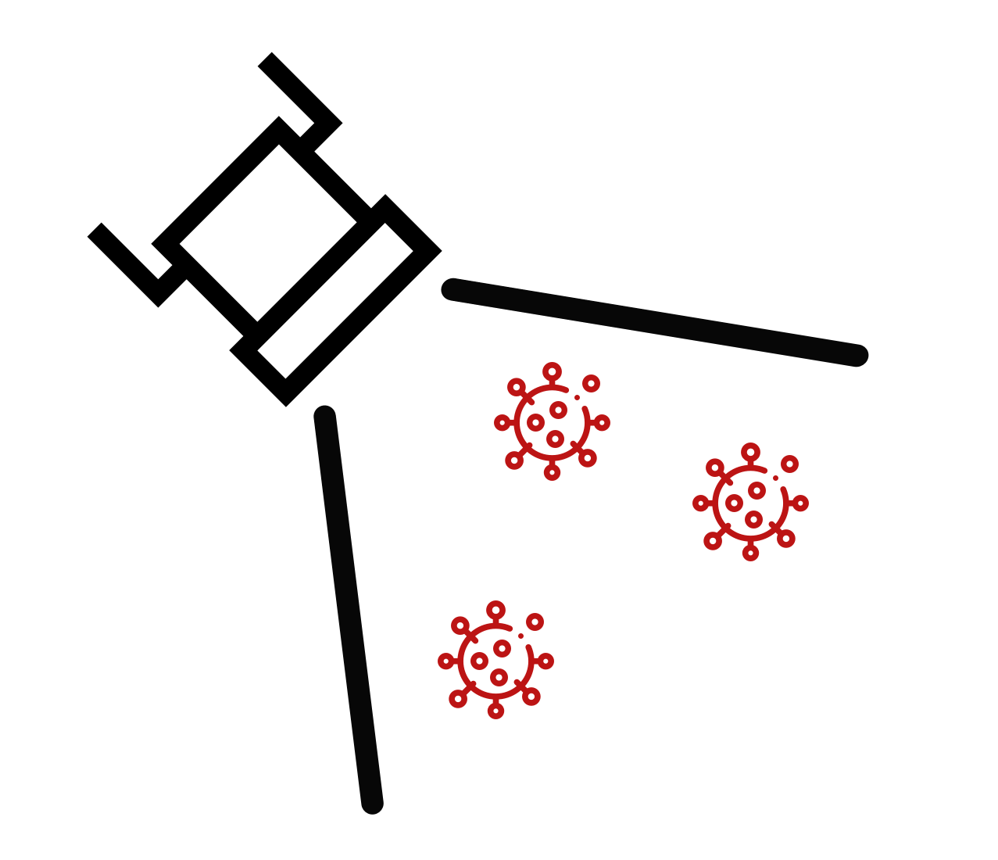
1) Intake
Sample Tubes
Clean tubes - spray wipe with ethanol/alcohol and wipe tubes
Intake with App (can also do during Amp heating)

Slide 2
2) Make 1X Inactivation
Saline Solution
Add 100X Inactivation Solution to Saline
Saline 5 mL | Saline 15 mL | Saline 50 mL
100X IS 50 μL | 100X IS 150 μL | 100X IS 500 μL

Slide 3
3) Add 1X Inactivation
Saline Solution to Sample Tubes
Add 1mL of inactivation saline solution (1XISS) to each sample tube
One sample tube open at a time

Slide 4
4) Heat to Inactivate Samples
Water Bath (set at 99°C)
Heat 8 mintues
Cool 10 minutes
Dry Heat Block for 1.5mL sample tubes (set at 95°C)
Heat 5 mintues
Cool 5 minutes

Slide 5
5) Make
Reaction Mix
Add CLAMP MM and Primer Soln (PGS) to 1.5mL tube
Aliquot into Strip8 tubes or 96 well PCR Plate
8 Rxns | 16 Rxns | 24 Rxns | 48 Rxns
PGS 92 μL | PGS 183 μL | PGS 275 μL | PGS 550 μL
CLAMP MM 109 μL | CLAMP MM 218 μL | CLAMP MM 328 μL | CLAMP MM 655 μL
Combine in New 1.5mL
Tube

Slide 6
6) Add Sample
to Reaction
Add 2μL from each sample tube to corresponding well
Aliquot into Strip8 tubes or 96 well PCR Plate

Slide 7
7) Heat Amp Reactions
Heat at 65ºC for 25 min
Set personal timer (on phone) for 24 min

Slide 8
8) Log and
Report Results
Let samples cool for at least 1 minute before taking photo
Crop and apply vivid filter
Log Amp Run Form with QR code link

